Slide 1
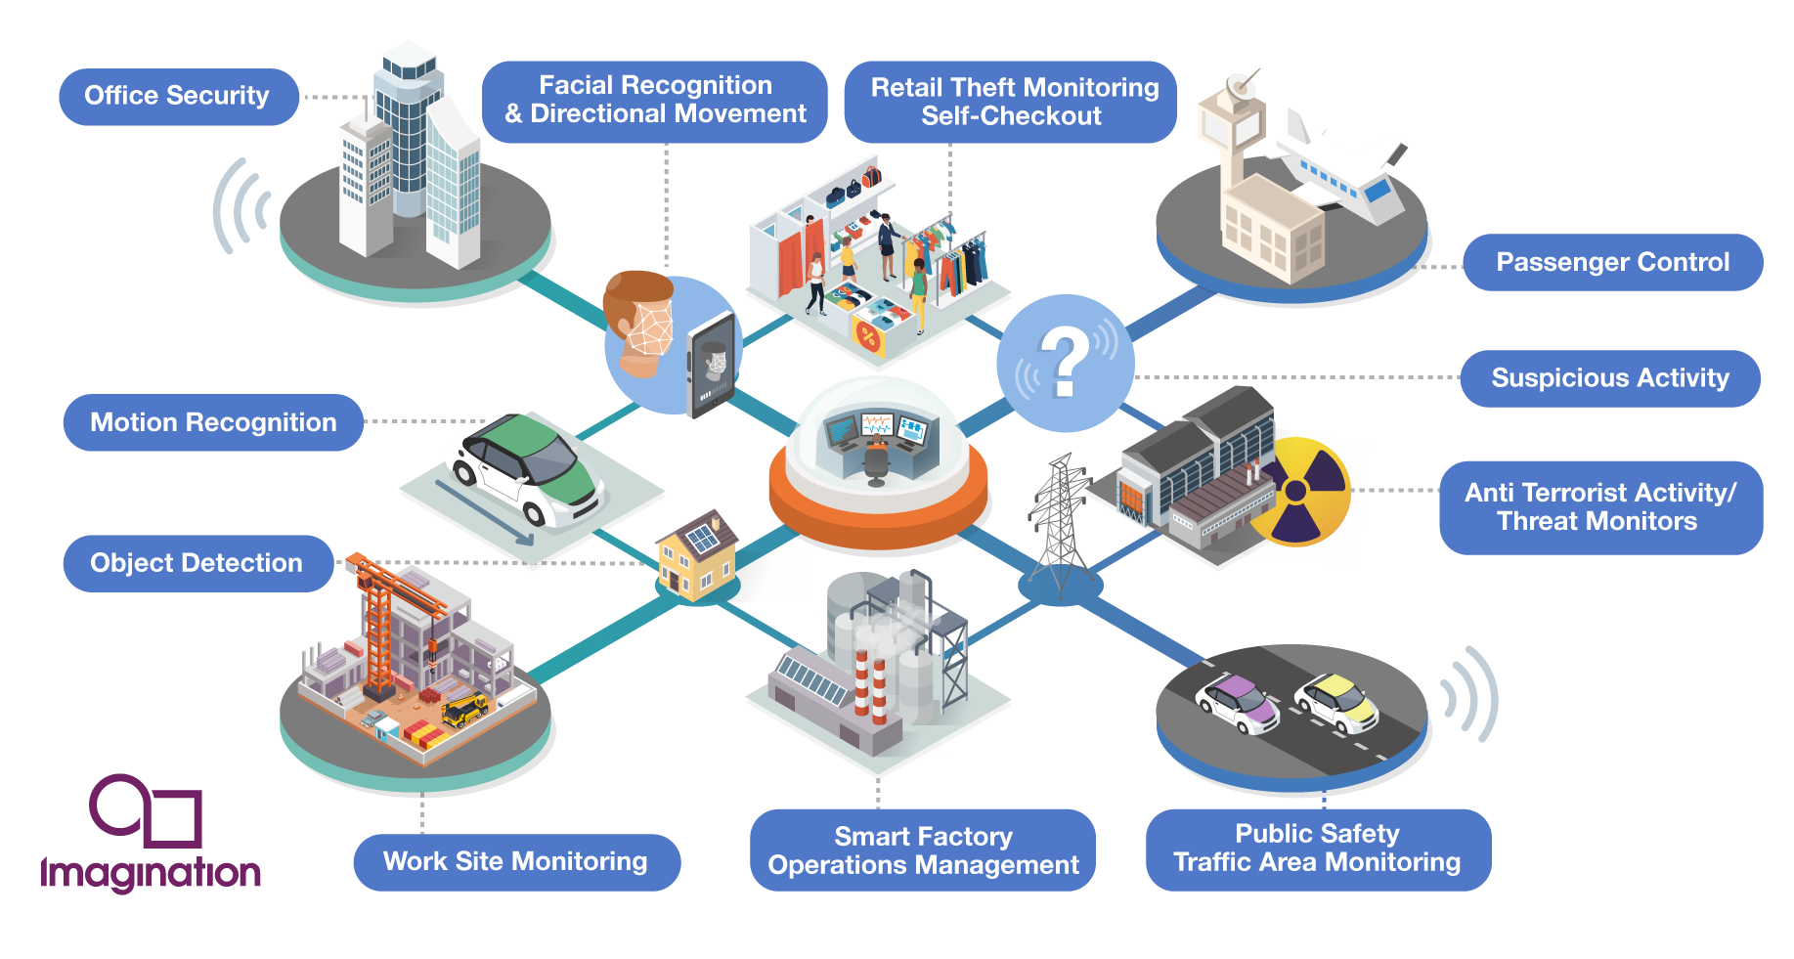
COMPUTER VISION
Presented by:
M.Rajasri
V.Neeraja

Slide 2
CONTENTS
Introduction
Evolution
Key Components
How Does Computer Vision Works in Retail Industry
Technologies Integration with Computer Vision
Applications
Role of Computer Vision in Self Driving Car
Advantages & Disadvantages
Future Scope
Conclusion

Slide 3
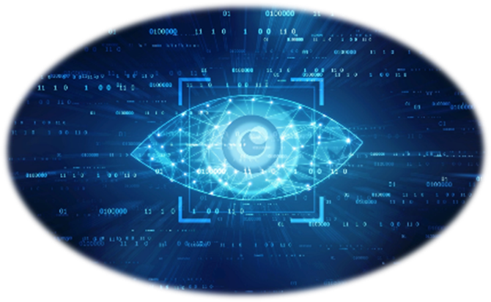
INTRODUCTION
Computer vision is a rapidly evolving field of artificial intelligence and computer science that focuses on enabling computers to interpret and understand visual information from the real world. It involves the development of algorithms and techniques to extract meaningful insights from images or videos.

Slide 4
EVOLUTION OF COMPUTER VISION
1950-1960:CharacterRecognition and Edge Detection
1970-1980:Shape Analysis and Object Recognition
1990-2000:Advances in image processing and Machine Learning
2010:Deep Learning Revolution
Integrated With Augmented Reality and Virtual Reality
Application In Autonomous System
Cross Domain Applications

Slide 5








KEY COMPONENTS

Slide 6
Image Acquisition: Gathering visual data from cameras, sensors, or other imaging devices.
Preprocessing: Enhancing and cleaning the acquired images to improve their quality and facilitate subsequent analysis.
Image Segmentation: Partitioning images into meaningful regions or segments to facilitate higher-level analysis.
Feature Extraction: Identifying and extracting relevant features from images, such as edges, corners, textures, or color distributions.
Object Detection: Identifying and categorizing objects or patterns within images or video streams.

Slide 7
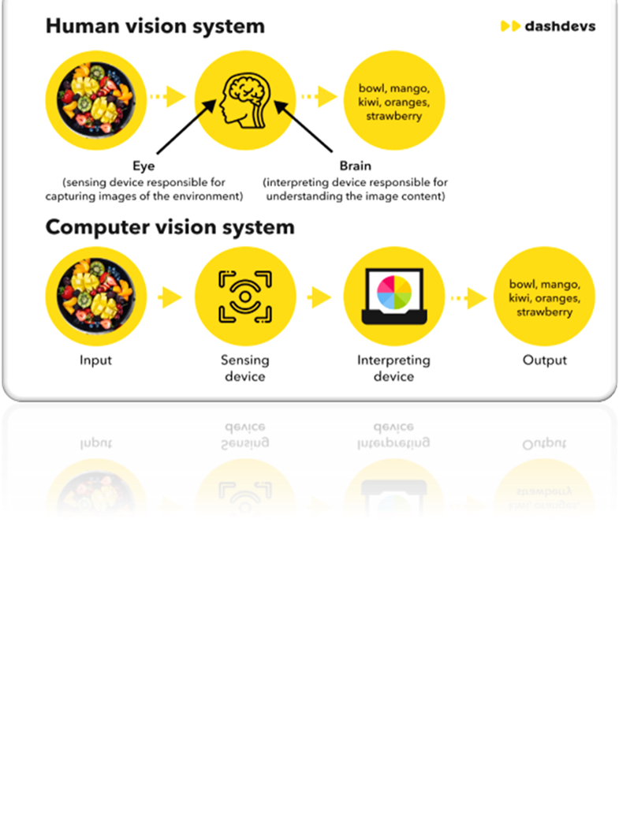
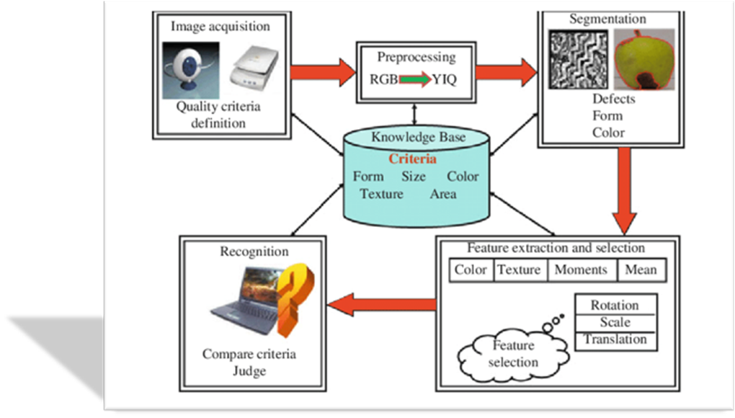

Slide 8

Product Recognition and Categorization
Inventory Management
Planogram Compliance
Checkout and Payment Automation
Customer Analytics
Personalized Recommendations
Loss Prevention
Visual Search and Product Discovery
Augmented Reality(AR) and Virtual Try-on

Slide 9
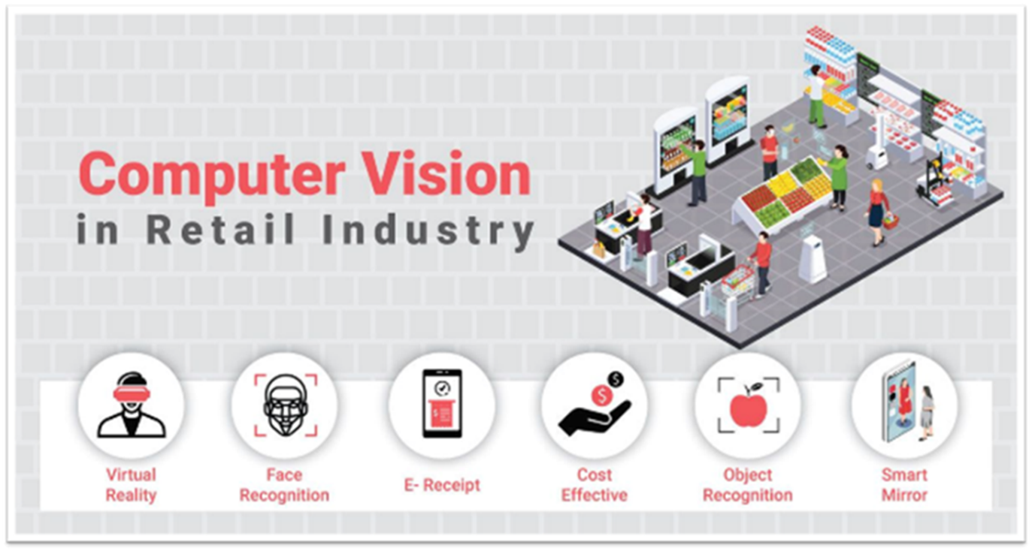
HOW DOES COMPUTER VISION WORKS IN RETAIL INDUSTRY

Slide 10
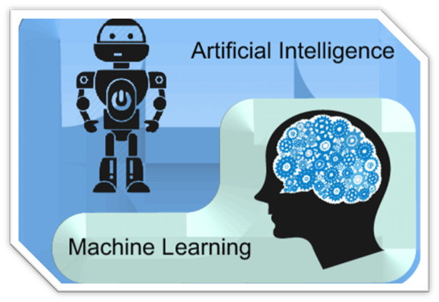
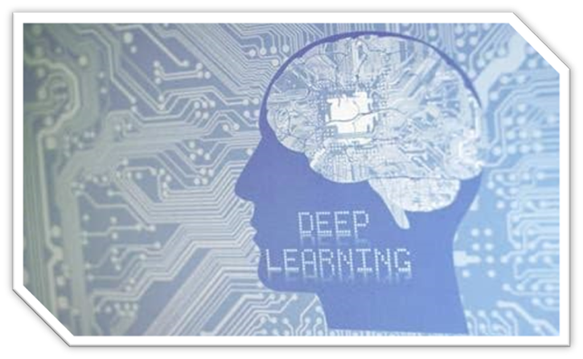
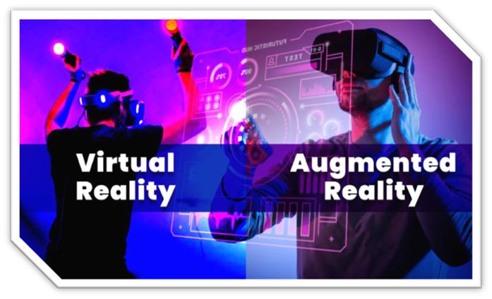
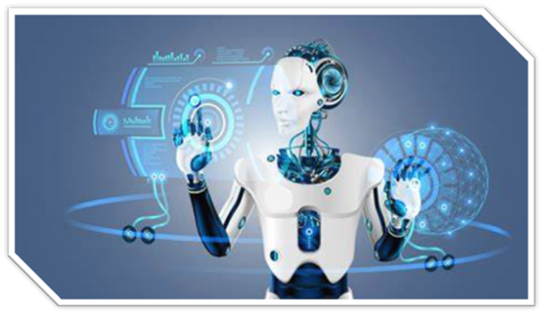
TECHNOLOGIES INTEGRATION

Slide 11
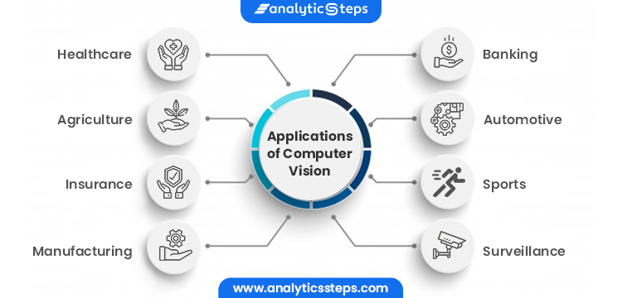
APPLICATIONS

Slide 12
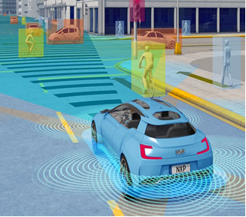
ROLE OF COMPUTER VISION IN SELF DRIVING CARS
Perception: Computer vision processes visual data from cameras, LiDAR, and other sensors to perceive and understand the car's environment.
Object Detection: Identifies and categorizes objects such as pedestrians, vehicles, and obstacles, crucial for avoiding collisions.
Lane Detection: Recognizes lane markings and road boundaries to ensure accurate and safe navigation.
Traffic Sign Recognition: Interprets traffic signs and signals, allowing the vehicle to follow traffic rules and regulations.

Slide 13
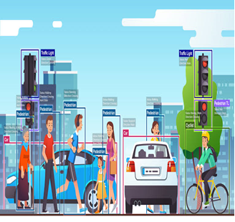
ROLE OF COMPUTER VISION IN SELF DRIVING CARS
Mapping and Localization: Creates maps of the environment and determines the car's precise location, aiding navigation.
Obstacle Avoidance: Analyses real-time visual information to make decisions that prevent collisions with obstacles or other road users.
Path Planning: Utilizes visual input to plan a safe and efficient route, considering traffic conditions and the vehicle's destination.

Slide 14
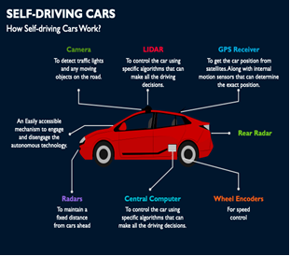
ROLE OF COMPUTER VISION IN SELF DRIVING CARS
Autonomous Navigation: Integrates computer vision outputs with control systems to enable the vehicle to navigate autonomously, adjusting in real-time based on visual feedback.
Pedestrian Detection: Identifies and tracks pedestrians, enhancing safety by ensuring the vehicle responds appropriately to their presence.
Driver Monitoring: Monitors the driver's behaviour and attention through computer vision, ensuring a smooth transition between autonomous and manual driving modes.

Slide 15
ADVANTAGES & DISADVANTAGES
ADVANTAGES | DISADVANTAGES
Automation | Privacy Concerns
Accuracy | Environmental Sensitivity
Speed | Resource Intensiveness
Scalability | Interpretability Challenges
Insights from Visual Data | Security Risks
Enhanced Safety and Security | Ethical Considerations
Innovation and New Possibilities | Socio-Economic Impact
Accessibility | Data Complexity

Slide 16
FUTURE SCOPE
Autonomous Systems
Healthcare
Augmented Reality (AR) and Virtual Reality (VR)
Smart Cities and Infrastructure
Retail and E-commerce
Security and Surveillance
Industrial Automation
Environmental Monitoring and Conservation
Accessibility
Human-Computer Interaction

Slide 17
CONCLUSION
In conclusion, this paper presentation has provided a comprehensive overview of the field of computer vision, highlighting its importance, advancements, and applications. We have explored various topics including image acquisition, pre-processing, feature extraction, object detection and recognition, image segmentation, and scene understanding, elucidating the underlying algorithms and techniques employed in each stage of the computer vision pipeline

Slide 18
THANK YOU

